Slide 1
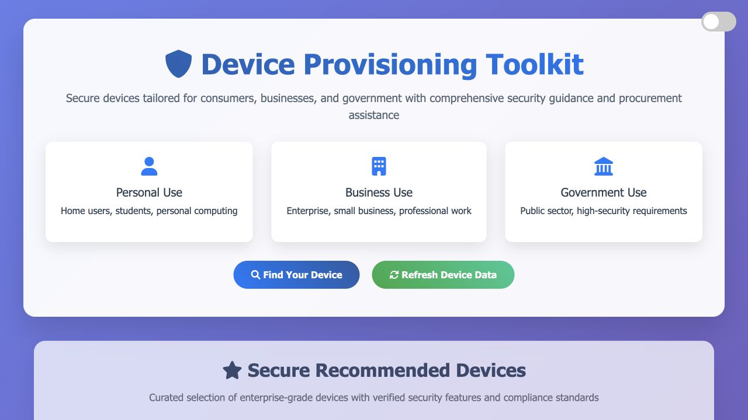
UNDERGRADUATE RESEARCH → WORKING PRODUCT
How do we decide what devices we provide?
A security-focused comparison and provisioning toolkit built from the dissertation.
Nathan Brown-Bennett • BSc Cyber Security & Digital Forensics

Slide 2

THE RESEARCH QUESTION
The buying decision was missing a security standard
The dissertation examined how governments, schools, employers and consumers choose devices—and whether security, practicality and reliability are considered together.
The gap
Guidance existed in fragments. Buyers could compare brand, price and specifications, but had no single workflow that translated security research into a usable decision.
Source: BSc dissertation, 18 July 2024

Slide 3
WHAT THE DISSERTATION FOUND
Three gaps kept recurring across the research
Security arrives late
Guidance is fragmented
People need usable advice
Device decisions often begin with price, brand and familiarity; security is added after selection.
Hardware risks, software hardening and user capability are rarely explained in one place.
A technically correct recommendation still fails if buyers cannot understand or apply it.
The product opportunity was not another comparison list. It was a decision tool that could connect research to action.

Slide 4
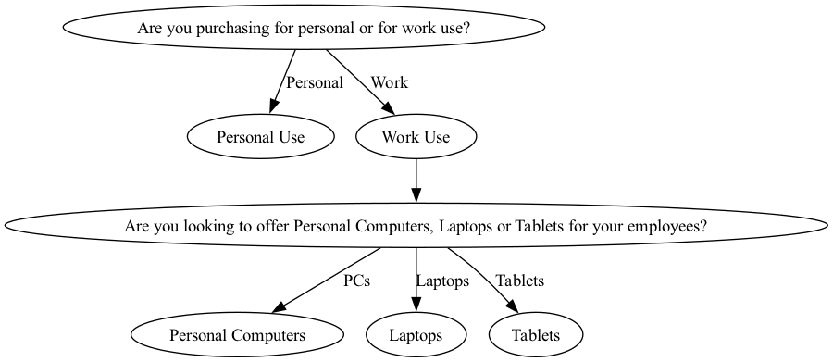
FROM DISSERTATION TO DESIGN
Research became a repeatable provisioning framework
The framework connects
• Buyer and user needs
• Hardware security considerations
• Operating-system and software controls
• Practicality and maintainability
• Clear recommendations

Slide 5
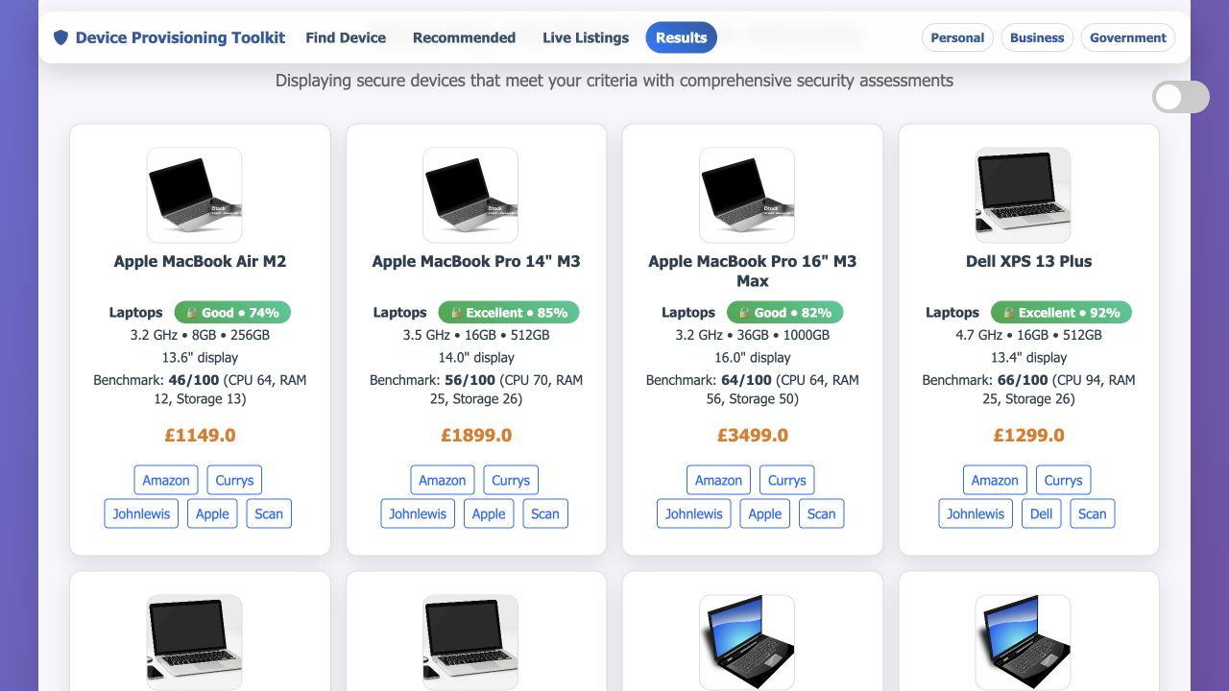
WORKING PRODUCT
The current toolkit makes the research usable
What exists now
A working Flask application with device discovery, structured comparisons, security guidance, purchase context and provisioning recommendations.
Python • Flask • SQLite • Graphviz • Pandas

Slide 6
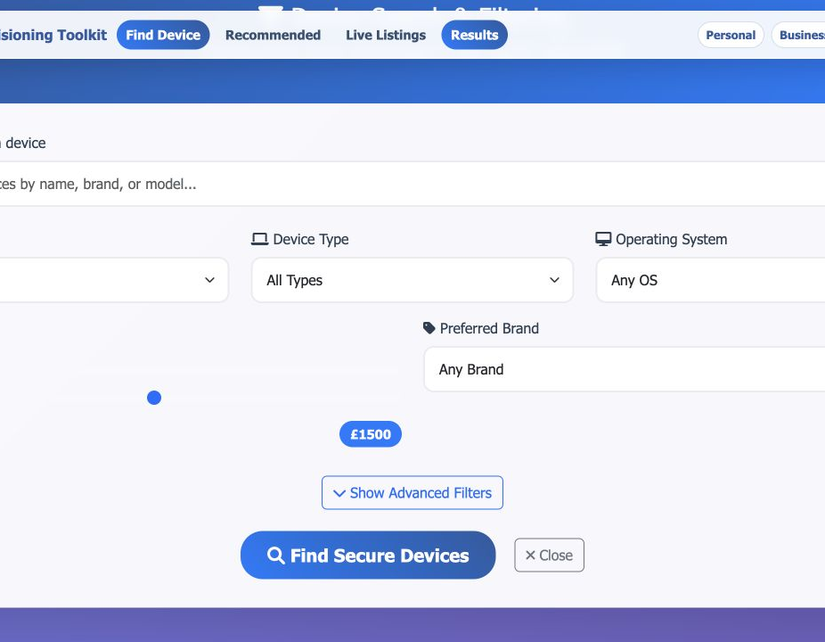
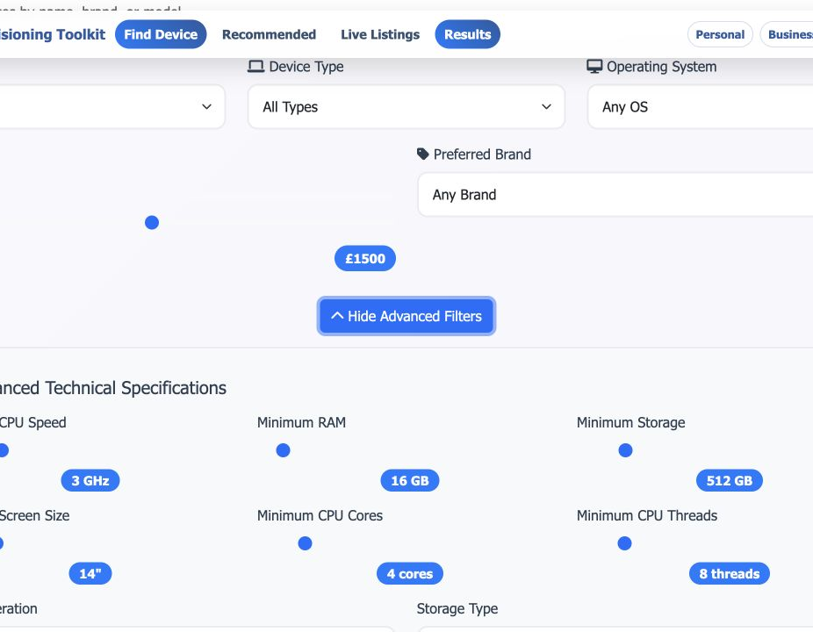
CURRENT INTERACTION
Search starts with the person, not the specification sheet
Describe the real use case
Refine the technical requirements

Slide 7
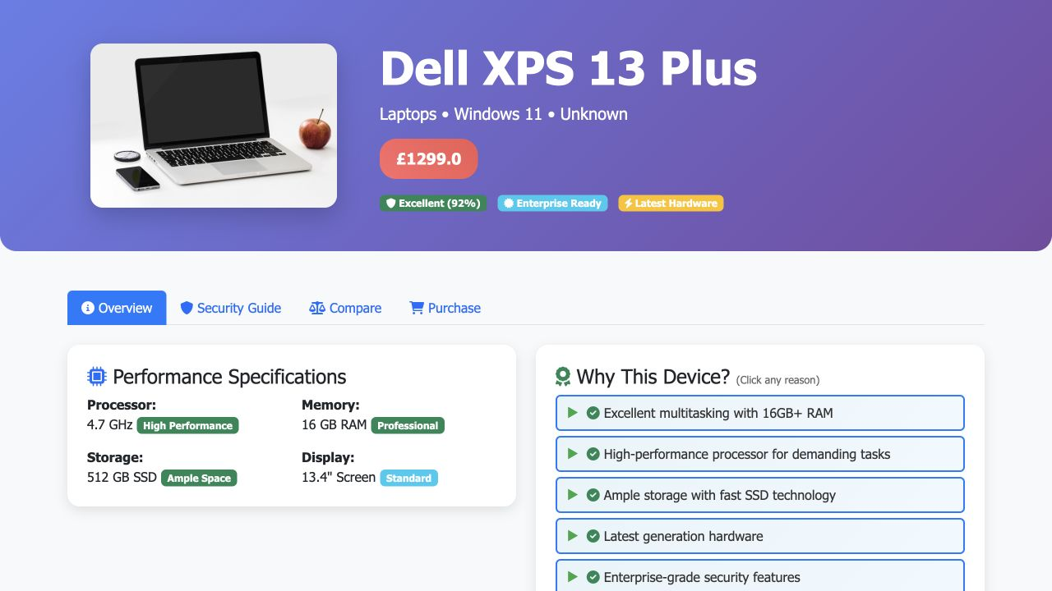
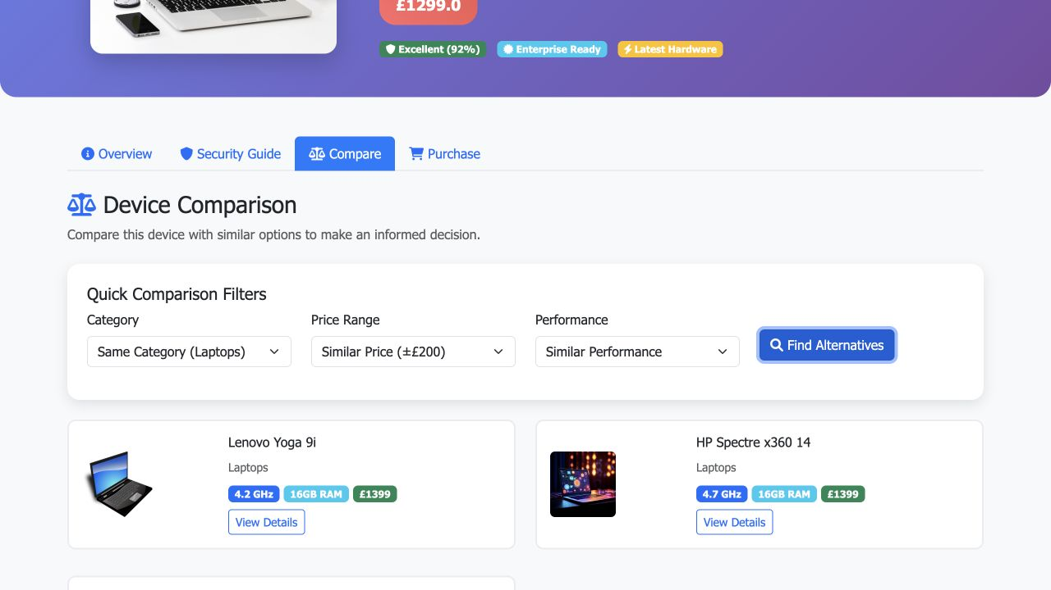
COMPARISON EVIDENCE
A device page explains the decision and the alternatives
Specifications and reasoning
Comparable alternatives

Slide 8
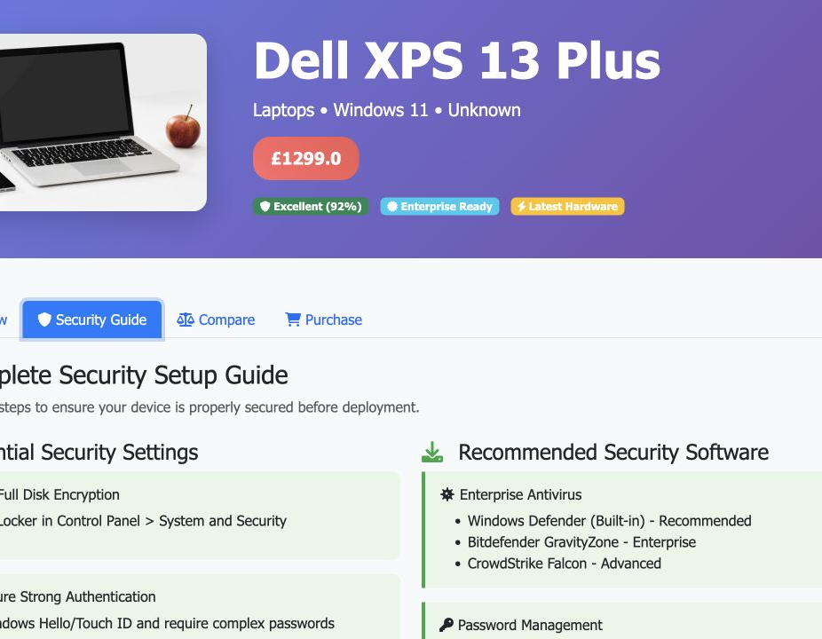
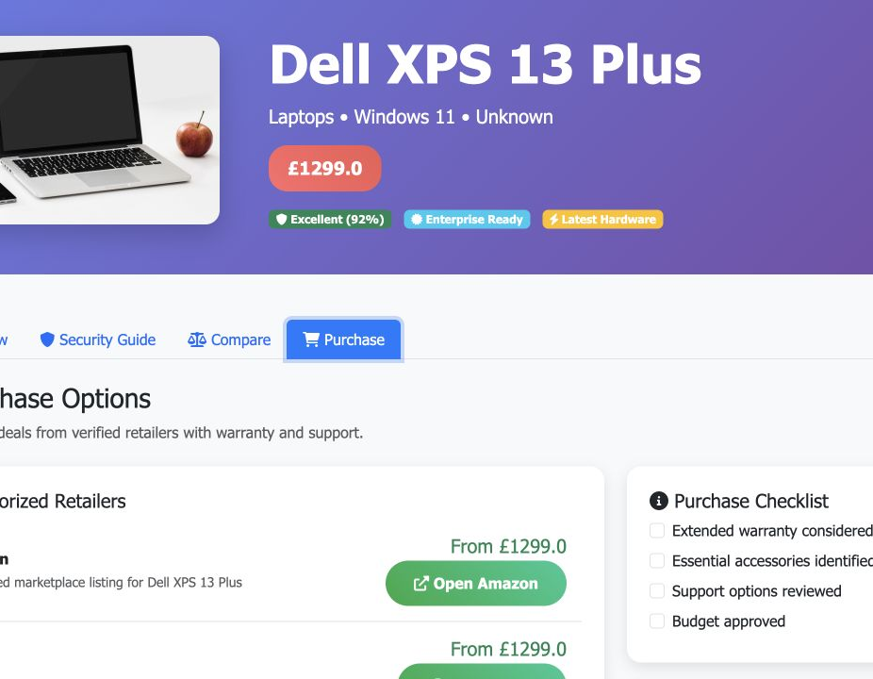
GUIDANCE AFTER SELECTION
Selection leads to setup and procurement guidance
Secure the device before deployment
Complete the buying decision

Slide 9
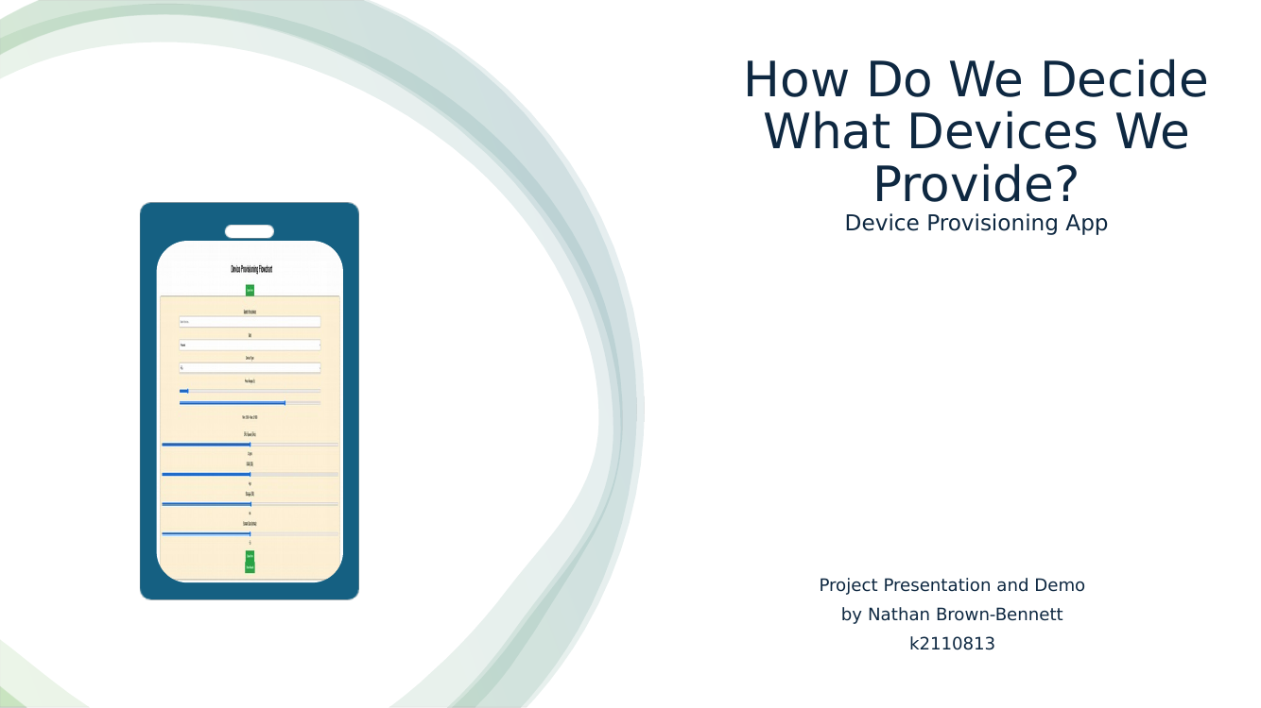
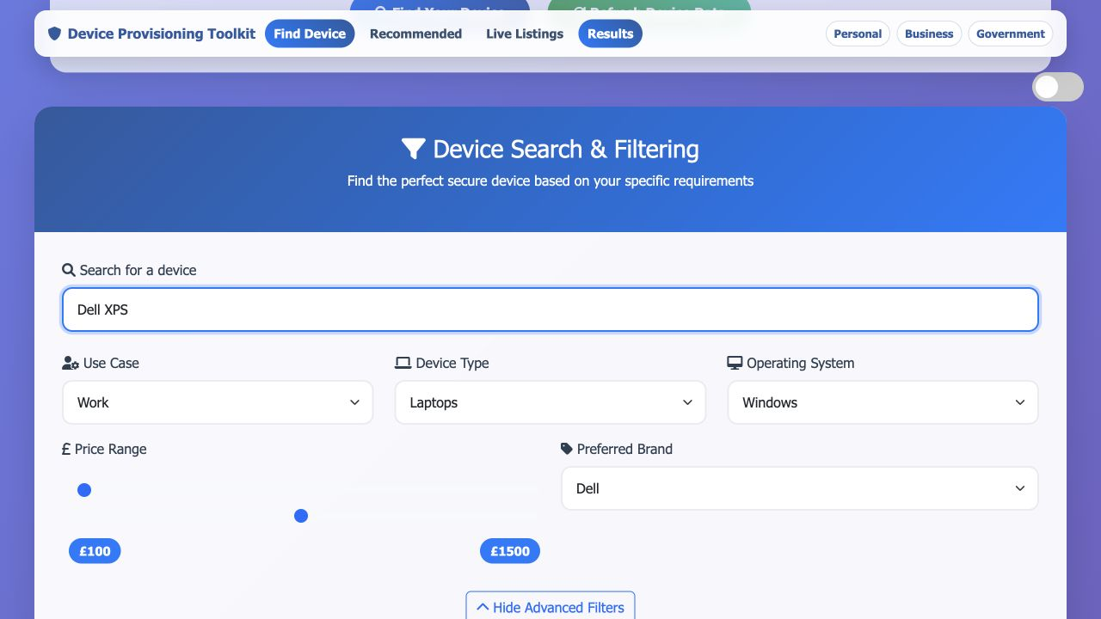
PROJECT EVOLUTION
The strongest evidence is the progression from question to product
2024
Dissertation
2024
Original presentation
Current
Working toolkit

Slide 10
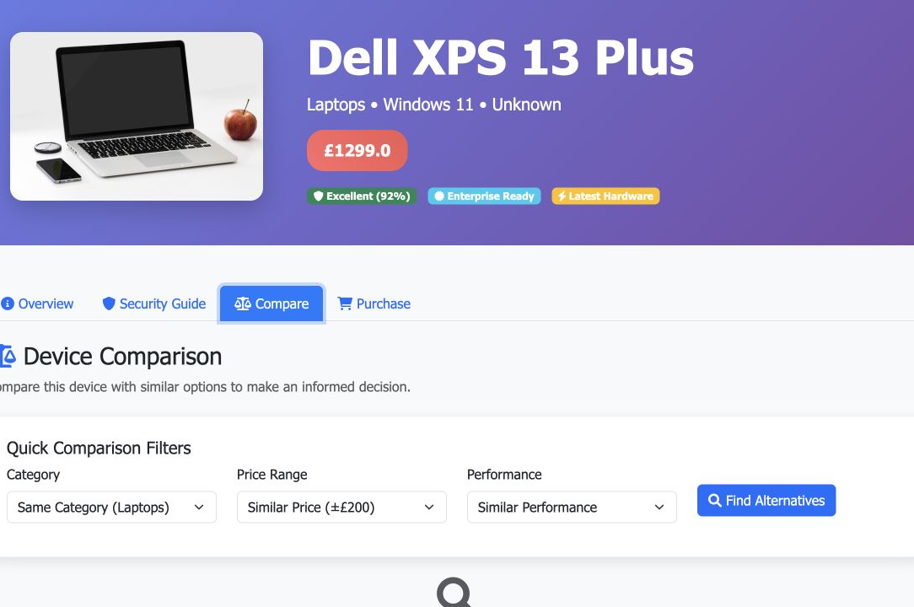
IMPLEMENTATION
A lightweight stack keeps the working prototype portable
Product architecture
Python + Flask
Application and routing
SQLite + Pandas
Structured device evidence
Graphviz
Decision and provisioning flows

Slide 11
WHAT COMES NEXT
The next phase is stronger evidence, scoring and organisational validation
Broader evidence
Expand and maintain the device dataset with clearer provenance.
Explainable scoring
Make every recommendation traceable to transparent criteria.
Operational validation
Test workflows with procurement, IT support and security teams.
The product is already useful as a demonstrator; the opportunity is to make its evidence and operation durable enough for real organisations.

Slide 12
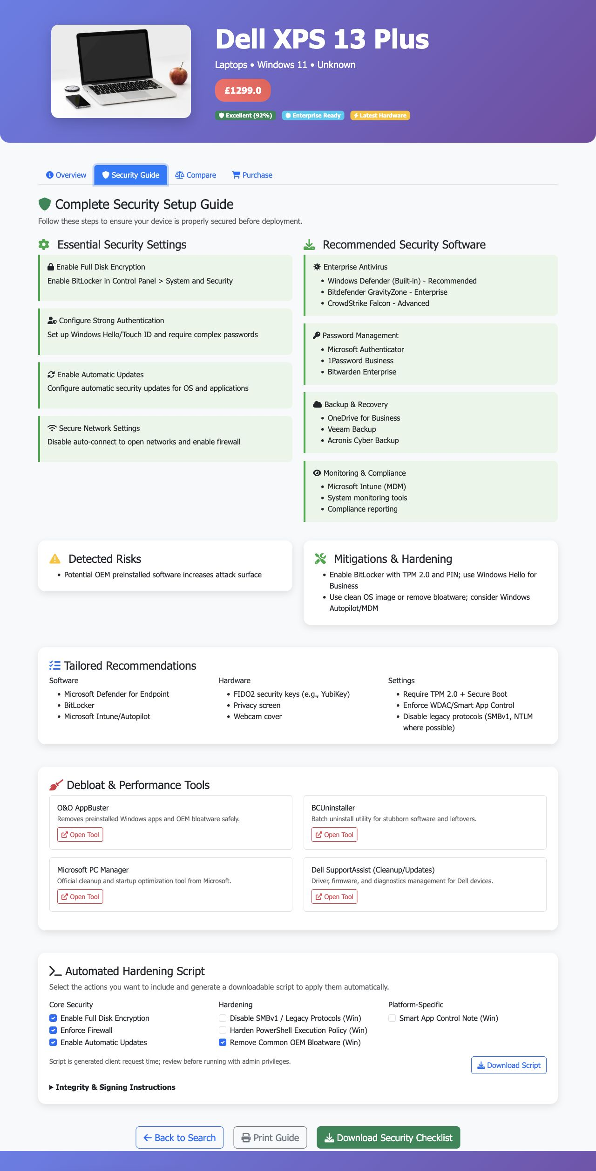
I build what should exist
This project started with a missing standard and became a working tool that makes device security decisions easier to understand and act on.
Dissertation
nathanbrownbennett.github.io/NathanBrown-Bennett/assets/documents/device-provisioning-dissertation.pdf
Repository
github.com/NathanBrownBennett/Dynamic-Flowchart-For-Device-Provisioning-

